Slide 1
Section 7.8: Hyperbolic Trigonometry

Slide 2
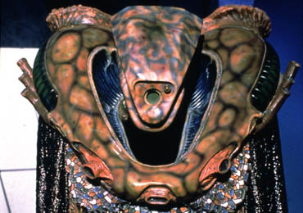
Definitions
Not the same Kosh
Etc…

Slide 3
Why call them trig functions??

Slide 4
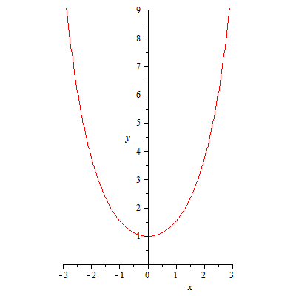
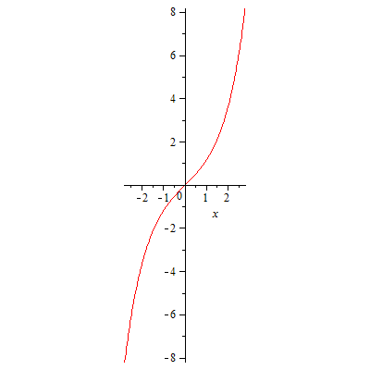
Why call them trig functions??
Catenary

Slide 5
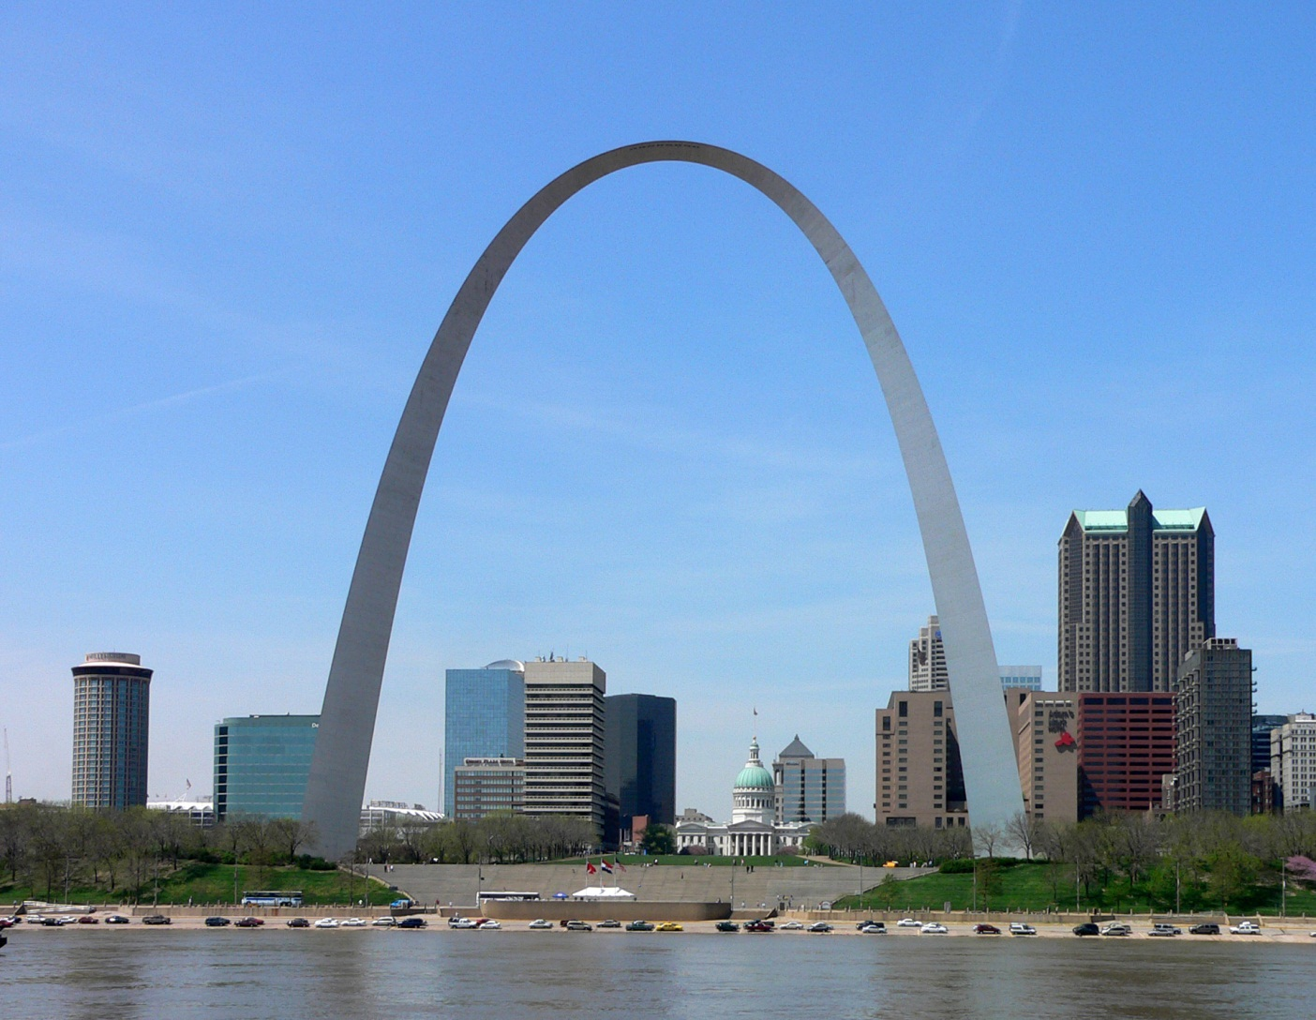
Better Known Catenary

Slide 6
Why call them trig functions??
Identities

Slide 8
The Real Reason for the Similarity

Slide 9
The Three Geometries
Euclidean

Slide 10
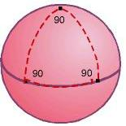
The Three Geometries
Spherical

Slide 11
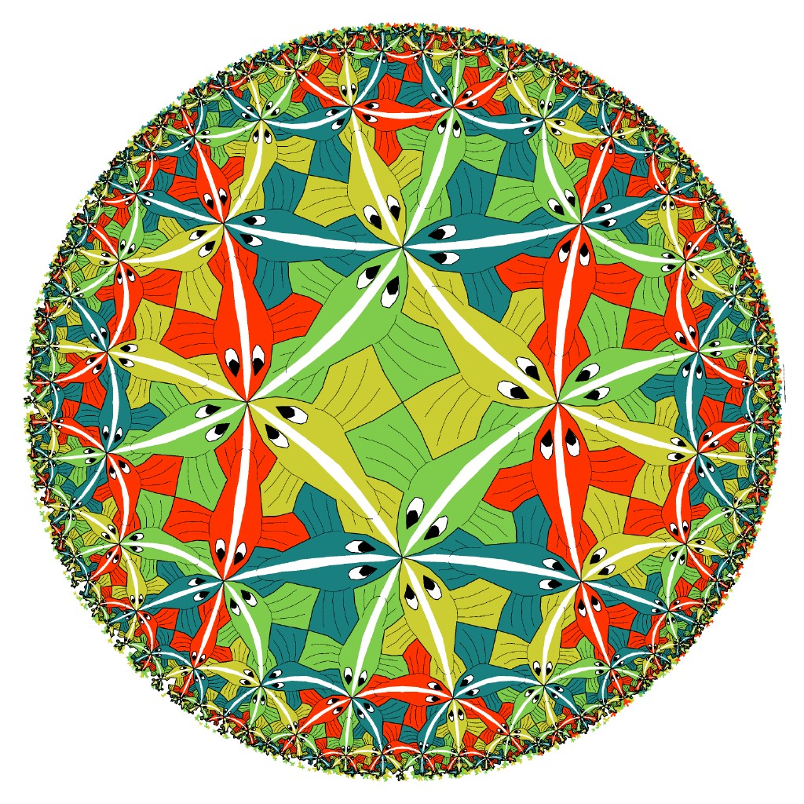
The Three Geometries
Hyperbolic

Slide 12
The Three Laws of Cosines
Euclidean
Spherical
Hyperbolic
c
b
θ
a

